Slide 1
Online Betting System based on Blockchain Group Member Jian Min 001491533 Mibin Zhu 001424937 Mingyu Liu 001498402

Slide 2
Introduction
1

Slide 3
Introduction
Nowadays, the gambling industry has gradually became legalized, no matter on offline or online. But there still have some problems in this industry, not all the platform can be trusted, some platform may take your money and gone, and you have no way to find them. To solve this problem, we get the idea of using the blockchain technology.

Slide 4
Justification
2

Slide 5
Justification
There have some problems for recent gambling industry, which is the reason why we need to make this blockchain system.
1. User authenticity is uncertain
When we participated in a gambling or sports quiz online, we do not know if the other party is a real user, maybe ‘he’ is just a robot set on the platform.
2. Fairness
Online gambling systems are implemented through code functions. Developers are free to modify the code in the system to achieve the role of operating the game.

Slide 6
Justification
3. Safety issues of money
When users enter the platform, they need to recharge virtual currency, and when they leave, they use virtual currency to exchange real money. In this process, the entry and exit of money may be operated unsafe.
4. International payment issues
In some global online gambling platforms, cross-border payments are still difficult to solve. While the digital currencies in blockchain systems are not affected by national borders.
5. User privacy issues
When users log in to their online gambling platform's account, some personal information is necessary. All these information should be protected to a certain extent, and if any of them is wrong, the user's personal information will be leaked.

Slide 7
Aims
3

Slide 8
Aims
When we write a contract using blockchain technology, we can achieve the following aims and advantages.
1. Blockchain‘s transparency and anonymity
Users log in to their account with a private key. This private key matches a unique address, and users can track the ins and outs of their assets through this address.
2. Blockchain supports global payments
The cryptocurrency built on the blockchain is fully virtualized. Cross-border payments can be realized in the system without exchange, which is equivalent to the inherent world currency.

Slide 9
Aims
3. Fairness of the blockchain
Blockchain technology provides online gambling platforms with the opportunity to prove their 100% honesty, completely changing the old habits of fraud.
4. Blockchain technology is anonymous
Blockchain technology greatly protects the privacy of individuals through mathematical encryption, and users' assets on the blockchain will be extremely secure.

Slide 10
Methodology
4

Slide 11
Methodology
1.Solidity
Solidity is an object-oriented programming language for writing smart contracts. It is used for implementing smart contracts on various blockchain platforms
2.React
React is a JavaScript library for building user interfaces. It is maintained by Facebook and a community of individual developers and companies.
3.Truffle Suite
A world class development environment, testing framework and asset pipeline for blockchains using the Ethereum Virtual Machine, aiming to make life as a developer easier.

Slide 12
Implementation
5

Slide 13
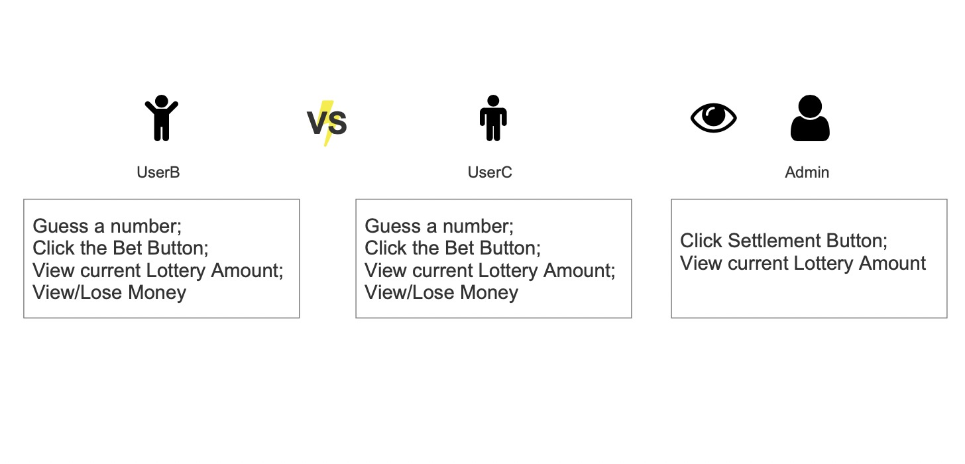
Implementation
Simulation of the lottery purchase process
Firstly, suppose there have three people A, B and C in this system. Where A is a manager role, the duty of A is just for clicking the “Settlement” button in this process. User B and C are the buyers of the lottery, they may have competition with each other to guess the number for being the winner.

Slide 14
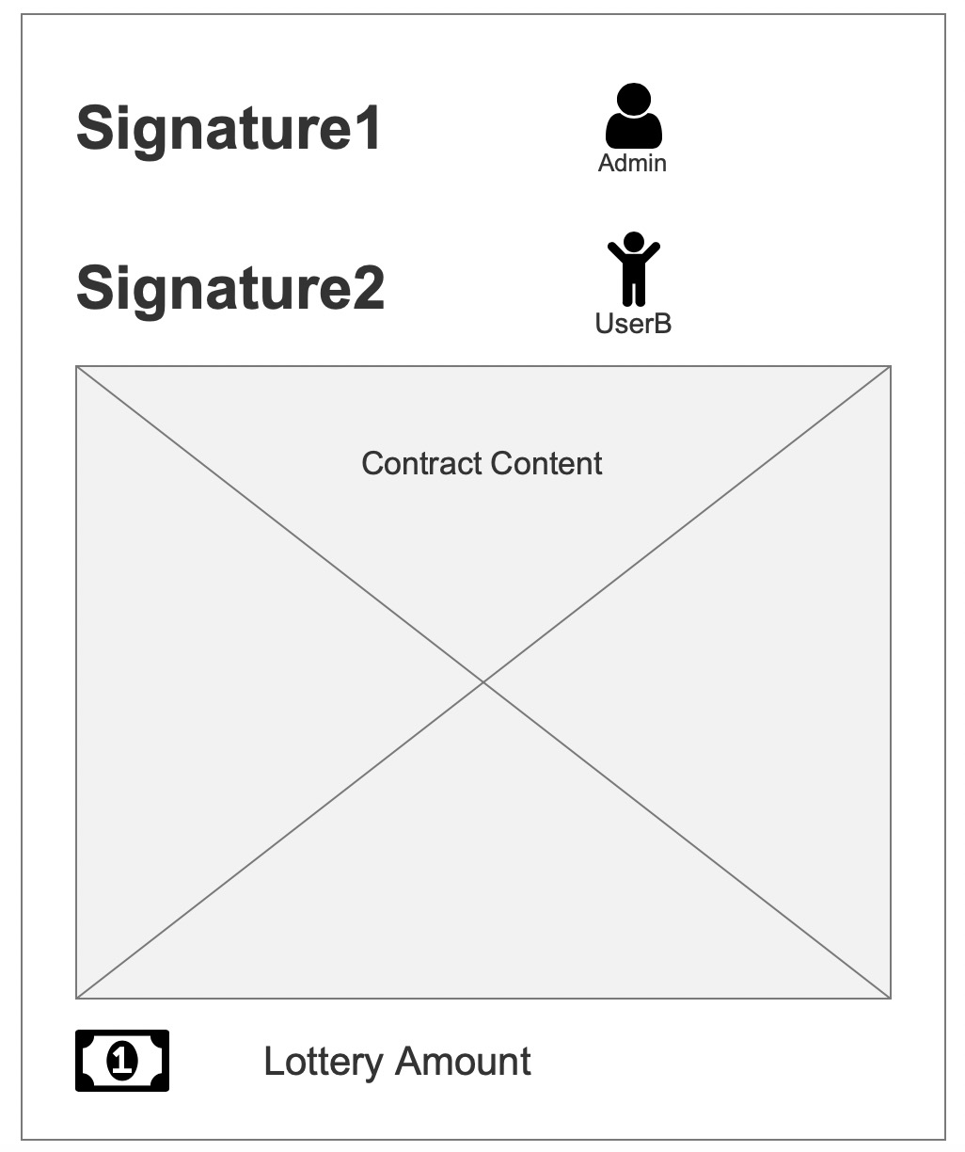
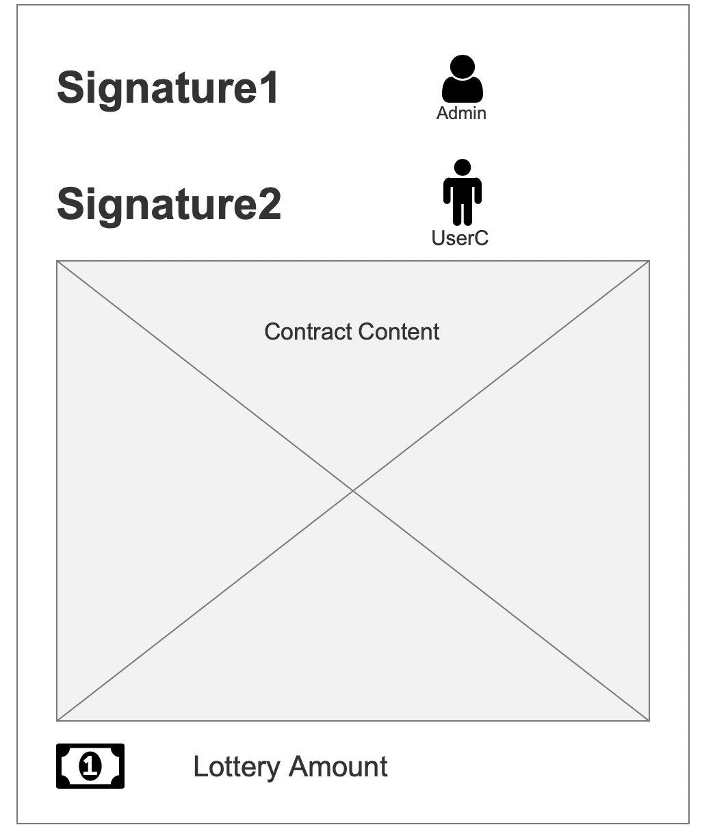
Implementation
This system is still a decentralized system, because we have contracts between A & B and A & C.

Slide 15
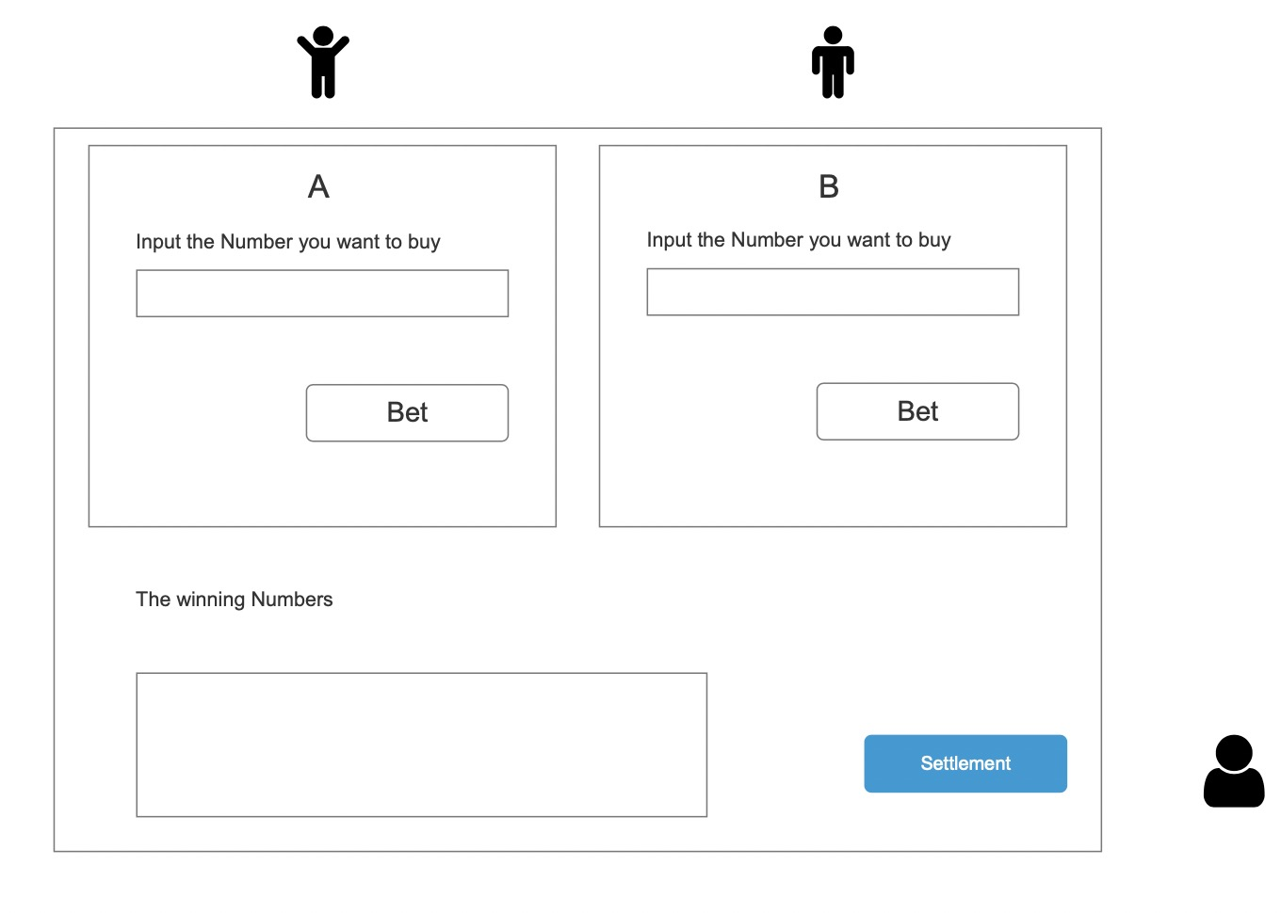
Implementation
Secondly, we look back to the lottery purchase process.

Slide 16
Implementation
Finally, when manager A clicks the “Settlement” button, a number will be generated by the system by default, and then this number is compared with the lottery number which are bought by the users. We may have following 3 conditions:
Condition 1, only one person guessed correctly, then the money will be given to that person depended on the contract.
Condition 2, if more than one person guessed correctly, the money will be distributed to each person, while the percentage will depend on the amount they are betting for.
Condition 3, If no one guessed right, the contract will return the money to each person in the betting system.

Slide 17
References
6

Slide 18
References
Solidity definition : https://en.wikipedia.org/wiki/Solidity
Solidity develop : https://solidity.readthedocs.io/en/develop/
React definition : https://en.wikipedia.org/wiki/React_(web_framework)
Truffle suite : https://www.trufflesuite.com/docs/truffle/testing/writing-tests-in-solidity

